Slide 1
IFRS 4 Phase II: L’oeuvre au noir
10th Novembre 2014
Guy Castagnoli / Eric Dal Moro
Notes:
1

Slide 2
A few personal encounters with IFRS 4 Phase 2
ASTIN subsidizing the IAA monograph on Risk Margin – Decision in 2011 in Madrid
IASB presentation in 2013 at EY offices in Zurich
ICA 2014 – Washington DC
  Presentation by IASB members on IFRS 4 Phase 2
  Presentation on the status of the IAA Risk Margin monograph

Slide 3



A few encounters with IFRS 4 Phase 2

Slide 4
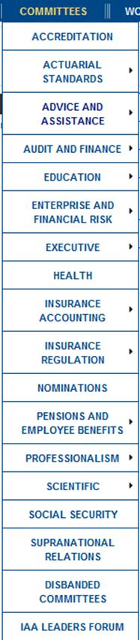


IAA and IASB
Discussions between IAA and IASB are on-going
  Collaboration in Insurance, Pensions and Discounting
  IAA is a frequent commenter on IASB’s EDs
  Latest topic is what will likely become IFRS 17 (= IFRS 4 phase 2)
  IAA Monograph on Risk Adjustment will support Risk Adjustment Margin Calculations under IFRS 17
  Also, the confidence level disclosure related to the presence of the risk margin should be part of the monograph
The IAA is an organization structured along committees
In the IAA, the Insurance Accounting Committee and its subcommittee, the Education and Practice subcommittee are involved in these discussions.

Slide 5
The IAA Committees
  Insurance Accounting (Education and practice sub-comm.)
  Insurance Regulation
  Pensions and Employee Benefits
  Professionalism
  Education Committee
  Social Security
  Supranational Relations
  Advice and Assistance
  The IAA member associations are represented in the committees by delegates

Slide 6
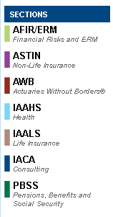
The IAA Sections
promote actuarial role in specific areas of practice
sponsor research of section’s field of activity
organize events of interest to individual actuaries
  ASTIN
  AFIR/ERM
  IACA
  AWB
  PBSS
  IAAHS
  IAALS

Slide 7
1 | IFRS 4 Phase 2 – A new comprehensive accounting standard
2 | IFRS 4 Phase 2 – Introduction
3 | Risk Adjustment Margin
4 | Challenges
5 | Example
6 | Conclusion

Slide 8
Timelines comparison for both Solvency II and IFRS Phase II
Solvency II
2006
QIS 1 / QIS 2
Pillars 1-2-3
development
2014
Plenary vote on
Omnibus II *
2009
SII - Directive adopted
1 January 2016
SII – Effective application of the Solvency II regime
2008
QIS 4
2007
QIS 3
2010
QIS 5
2005
Effective date of IFRS 4 Phase I
June 2013
IASB revised ED
2017/2018 ?
Effective date of standard IFRS 4 Phase II
1997
IASC approved a project on Insurance Accounting
2007
Discussion paper (DP) published
2010
Phase II Exposure Draft (ED) issued
Q4 2014 / H1 2015
Final Standard IASB
New
Implementation date of IFRS 9
IFRS 4 Phase 2
* Omnibus II is the legislation to amend Solvency II
Notes:
Although the IASB’s project has slipped back many times, the IASB are currently on target to produce a final standard in the second half of 2014 with likely implementation three years later.

Slide 9
Financial reporting for insurance contracts
Phase 1 towards Phase 2
Because it was not feasible to complete the project in time for the many entities that would adopt IFRS in 2005, the IASB split the project into two phases.
IFRS 4 Phase 2
A comprehensive standard
Market-consistent measurement:
Building block approach
Premium allocation approach as a proxy
Transparency, comparability, financial reporting
limited comparability and transparency
no cash flow projections
continue to allow various current and local accounting principles
an interim standard
IFRS 4 Phase 1
Limited improvements
Precise recognition, presentation, disclosure
Income statement based on deposit accounting

Slide 10
1 | IFRS 4 Phase 2 – A new comprehensive accounting standard
2 | IFRS 4 Phase 2 – Introduction
3 | Risk Adjustment Margin
4 | Challenges
5 | Example
6 | Conclusion

Slide 11
Building Block Approach (BBA)
This approach is relevant for insurance contracts with a coverage period of more than one year
Entities required to measure their insurance contracts using the current measurement model, where current estimates are re-estimated every reporting period
Best estimate
Expected future cash flows
Discounted at risk free rate
Risk Adjustment Margin
Future cash flows adjusted to take into account the time value of money
Explicit adjustment to reflect uncertainty in the amount and timing of the future cash flows
From premiums, claims and benefits
An explicit and unbiased estimate of the current value of expected future cash flows
Contractual Service Margin
The expected contract profit which eliminates any gain at inception of the contract
Margins
Notes:
Although the effective date is not yet set, the Building Block Approach is now more or less final
IFRS 4 phase 2 does not provide explicit guidance on the valuation techniques to be used for calculating the undiscounted probability weighted future cash flows (unlike Solvency 2) and will be open to interpretation. Best estimate assumptions will be used as a mean basis (i.e. no implicit prudence) for projecting cash flows.

Slide 12
Impact of IFRS 15 “Revenue from contracts with customers”
IFRS 15 introduces a new concept of revenue : revenue now emerges
with the fulfillment of so-called “performance obligations”
  traditional non-life UPR (unearned premium reserve) compatible
  although insurance is scoped out of IFRS 15, insurance contract revenue according to IFRS 4 Phase 2 will be consistent with IFRS 15
  while fees for investment management services give rise to revenue, receiving customer deposits does not !
  for insurance contracts, this implies that investment components of premiums and claims no longer flow through P&L
  the result is a form of deposit accounting for insurance contracts

Slide 13
New Format of Insurance Companies’ Income Statement
Components of insurance contract revenue (top line):
  prospective current estimate of claims and services (ex investment comp)
  change in the risk adjustment
  amortization of the CSM
  allocation to reporting period of acquisition expenses spread out over the coverage period
Other items in the Profit and Loss Statement
  actual claims and service expenses (ex investment components)
  changes in estimates of future cash flows that don’t adjust the CSM
  (claim reserves, onerous contracts)
  interest expense (locked-in yield curve w/non-par business, unless FVPL)
Other Comprehensive Income (when the FVPL option is not elected)
  movements in liability due to yield curve change

Slide 14
Two Accounting Policy Variants for the Income Statement
FVPL option: all changes of insurance contract liability flow through P&L
    well-suited for unit-linked business
FVOCI: analogous to former FAS 115’s “available for sale” investment classification for bonds, however, on the liability side of the B/S
    applicable to non-par business
    arguably suited for traditional life business when bonds are valued according to IFRS 9 FVOCI.
    interest expense on insurance contract liability is based on locked-in yield curve and flows through P&L
    residual change of liability measurement due to yield curve change goes through OCI (Other Comprehensive Income)
Comparability assured through common disclosures

Slide 15

Contractual Service Margin: A non-life example
Notes:
Treaty for one UWY covering all business started in the UWY. Premium is mostly paid during the said UWY even though the risk is spread unevenly along many years.
Decennale insurance in France

Slide 16
Contractual Service Margin: Endowment Insurance Zero-Profit-at-Issue

Slide 17
Contractual Service Margin: Amortization of CSM in the first four years

Slide 18
Contractual Service Margin: Currently Decided Features
Locked-in yield curve
  allows splitting of earnings into investment and underwriting income
Adjustment of the CSM for changes in expected cash flows for future coverage (this excludes changes in expected claim reserve cash flows)
Adjustment of the CSM for changes in the risk adjustment
  CSM and Risk Adjustment together more relevant and reliable?
CSM to be determined policy-by-policy
  no netting of profitable and onerous contracts before determining CSM
No adjustment of the CSM for changes in the measurement yield curve
  “Industry Proposal” would fully unlock CSM for participating contracts

Slide 19
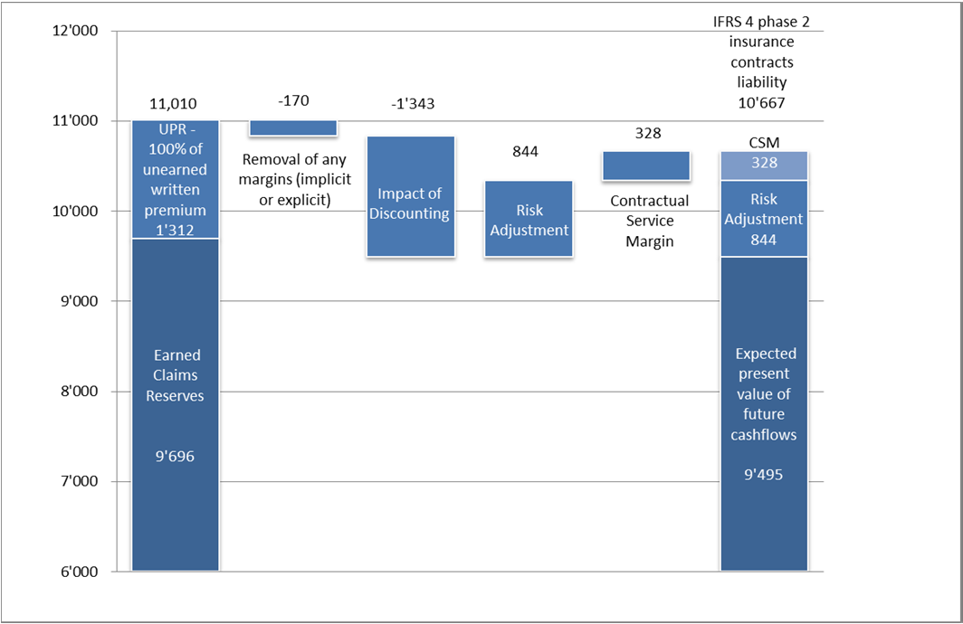
Building Block Approach (BBA) - Example
Notes:
In this example the IFRS 4 phase 2 insurance contract liability is shown to be slightly lower than current technical reserves. The impact on the technical reserves will vary
from one (re)insurance company to the other depending, for example, on the level of prudence contained in the current reserves, the nature of the business written (i.e. mix of long tailed and short tailed), the diversification benefits considered by the entity and profit profile.

Slide 20
1 | IFRS 4 Phase 2 – A new comprehensive accounting standard
2 | IFRS 4 Phase 2 - Introduction
3 | Risk Adjustment Margin
4 | Challenges
5 | Example
6 | Conclusion

Slide 21
Risk allowance
Risk margins reflect all risks associated with the insurance contract except those reflected through the use of market consistent inputs.
Solvency II
IFRS 4 phase 2
Risk margin
Prescribed approach: Cost of Capital
using 6% cost of capital
Depict the risk and uncertainty
To ensure that the technical provisions are equivalent to the expected amount required by another insurer to take over and meet the insurance obligations.
Allowance for diversification benefit
Risk adjustment
No prescribed technique
Some Risk Adjustment Techniques examples
Confidence Interval;
Conditional Tail Expectation (CTE);
Cost of Capital.
Depict the risk and uncertainty
An explicit allowance to reflect the compensation that the insurer requires for bearing the uncertainty surrounding the amount and timing of the cash flows that arise as the insurer fulfils the insurance contracts.
Allowance for diversification benefit based on an entity’s own view of risk
Notes:
APOG – Frank to discuss
Will not be comparable between companies

Slide 22
Risk adjustment
An explicit measurement of the effects of uncertainty about future cash flows is required with re-measurement at each reporting period
There are only a small number of well‐established methodologies currently available
  The International Actuarial Association (IAA) is expected to publish a monograph on recommended methods early next year
The IFRS risk adjustment is seen from the point of view of the company and not from the view of the transfer of a liability to a willing rational counterparty (like in Solvency 2).
Not much thought yet given to the risk adjustment measure for IFRS 4 phase 2
  Consideration needed on where to reflect surplus/deficiencies in the current booked reserves
  An attractive option: Value at Risk or the Tail Value at Risk where the resulting quantile would reflect the level of surplus or deficiency
  However, for consistency with Solvency II, Cost of Capital (CoC) approach may likely be applied

Slide 23

Risk adjustment – Y/E calculation
We assume that entities will choose to use the CoC method
  Involves a quarterly calculation of the SCR
For the most efficient company it will take 3 months to produce the final SCR from the beginning of the year. Consider example at SCOR for SST:
Step 4: Currently, it is compulsory to deliver the final SST report to Finma by 30th April
Step 3: Management (CRO, EC, Bod) usually takes one month to approve the report
  As a consequence, the draft report needs to be ready by 31st March
Step 2: Review groups peer‐review data inputs and first outputs of each risk module
  A few rounds of model runs are necessary to reach the final results
  Consequently, first results need to be produced by 28th February
Step 1: Before the first run, data needs to be input into the model
  Time needed to input data and for quality checks
  Certain data, i.e. planned data, still subject to discussion
  Best case, it is possible to start the very first run with the real data by 31st January
Notes:
Step 3: In itself, it is challenging for all of these committees to be able to effectively read and approve the report in such a small timeframe.
Step 2: Data inputs including reserves, premium, asset values, planned data for the year to come. First outputs of each risk module (non‐life risk, natcat risk, life risk, credit risk, asset risk, final consolidation, risk margin)
Step 1: The data relates not only to known amounts such as reserves or asset values but also to planned data like expected premium for the current year and to protection being bought by the company (e.g. retrocessions).

Slide 24
1 | IFRS 4 Phase 2 – A new comprehensive accounting standard
2 | IFRS 4 Phase 2 vs SII – Parallels and differences
3 | Risk Adjustment Margin
4 | Challenges
5 | Example
6 | Conclusion

Slide 25

Challenges
Risk Adjustment Margin
Discounted Reserves
Contractual Service Margin
Impact of discounting vs undiscounted BE reserve mvmts
Increase due to new contracts being written during quarter vs decrease due to amortisation of in-force business
Timing constraints for SCR calculation
Quarterly calculation needed
Reporting deadline for IFRS: Y/E for March / April
IFRS disclosure requirements and consistency with SCR
Work of explaining reserve mvmts will be doubled
Need to consider movement of yield curves by currency
Treatment of CSM is still subject to significant uncertainties
CSM is likely to be significant contributor to P&L due to its nature of embedded profits
Historical rates needed as the basis for P&L and current rates for the B&S
Effect of changes in discount rates represented in Other Comprehensive Income (OCI)
Notes:
Disclosures: IFRS 4 also requires disclosures on the nature and extent of risks that may affect the amount, timing and uncertainty of the cash‐flows. Such disclosure includes general information on risk exposure, risk management policy, credit risk, claims development and liquidity risks. The production of these disclosures is also closely related to the SCR production and consistency between IFRS and SCR should be monitored.
Quarterly Calculation: Unlikely internal model would be re-run at Q1 and Q3 e.g. for re-estimating the risk margin -> simplification needed
The impact of discounting on the reserves will have to be explained quarterly by checking the movement of yield curves by currency

Slide 26

Confidence interval disclosure
In Europe, the basis of calculation for the risk margin is likely to be the cost of capital.
MVM = CoC $\sum_{i=1}^{m}{\frac{E[SCR\left(i\right)]}{[1+ r_{0}(i+1)]^{i+1}}}$
During the last IAA committee meeting, there was no proposal to “convert” a cost of capital risk margin into a confidence interval.
  A new field of scientific development ?
Proba.
Risk margin
= Which confidence interval ?
Average
Reserves

Slide 27
Solutions
Risk Adjustment Margin
Discounted Reserves
Greater trust given to capital model, its output and people who run it
  Lighter approval process of the SCR
  Limited reviews by review groups
  More emphasis on output rather than engine
Use of simple capitalisation ratios
  Target ratios or benchmark used in quarterly recalculation
  Evidencing of SCR mvmts through analysis of the available capital mvmts
  Proxy for change of discounted liabilities w.r.t changes in yield curves
  Use modified duration of the liabilities
  Needed for multi-currency environment
CSM
Simplified amortisation assumptions
Sensitivity analysis on applied assumptions
Notes:
The modified duration is currently used in bond markets as a price sensitivity measure, defined as the percentage derivative of price with respect to yield.

Slide 28
1 | IFRS 4 Phase 2 – A new comprehensive accounting standard
2 | IFRS 4 Phase 2 - Introduction
3 | Risk Adjustment Margin
4 | Challenges
5 | Example
6 | Conclusion

Slide 29
Example - Assumptions
IFRS 4 phase 1
IFRS 4 phase 2
Estimate as at 1 January 2014:
  Reserves
  Unearned Premium
IFRS 4 phase 1 adjusted for:
  Discounting impact
  Market Value Margin (MVM)
  Contractual Service Margin (CSM)
Portfolio with 8 contracts
  Currency, inception date, premium, ULR and commission rate specified per contract
  Payment pattern, premium earning pattern, commission earning pattern and margin earning pattern are all assumed to be the same
  Premium reserves = 100% ULR * unearned premium
  Margin is the part of the premium above the combined ratio
  CSM should be adjusted to reflect the changes in the estimates of cash flows relating to future coverage or services
  Market Value Margin calculated using CoC method
  All risk relates only to reserve risk
  Reserve risk follows a lognormal distribution
  Risk measure is the value at risk at 99.5 %
  Yield curve for each currency as at 1 January 2014
  Portfolio contains 2 currencies, USD and EUR
Notes:
Reserve risk follows a lognormal distribution which parameters are provided by the reserve amount estimated under IFRS 4 phase 1 and by the coefficient of variation of the reserves of each individual contract

Slide 30
Balance Sheet as at 1 January 2014
Reserve levels are the same between both phases but split of reserves is different
On the basis of the above IFRS 4 phase 1 claims reserve of 825.4 EUR, the modified duration as at 1 January 2014 is estimated to be 1.92 (to be used later)
In some cases, we have done some simplifications (e.g. MVM) in order to have an acceptable level of complexity in the proposed calculations.
We must remember this is an extremely simple portfolio. For a “real‐life” (re)insurance company, the calculations could rapidly become extremely complicated.
Notes:
MVM calculation is simplified as all the amounts are first converted in EUR and then the patterns and discounting are estimated.
The CSM for each contract is estimated as the product of the total contract margin as at 1 January 2014 and the margin earning pattern.
In the next section we are going to analyse the potential movements on the above balance sheet in the following quarter (i.e. as at 1Q 2014) of activity assuming there is no new contract signed.

Slide 31
Balance Sheet as at 1 April 2014 assuming no changes
In order to estimate the Balance Sheets as at 1Q 2014 assuming no changes in ULR, CoV, Yield Curve, FX and commissions, we are just making the following short-cuts:
No new contracts are signed
The patterns for calendar year 2014 as at 1Q 2014 are equal to 75% of the patterns for calendar year 2014 as at 1 January 2014
The discounting will be done on the basis of 3 quarters for year 2014

Slide 32
Balance Sheet as at 1 April 2014 assuming Yield Curve changes
No change in undiscounted reserves but yield curve is lower
Only impacts IFRS 4 phase 2

Slide 33

Proxy Estimation of Yield Curve Changes
Modified duration is 1.80 as at 1Q 2014 and before the yield curve changes
  Same for all 4 elements due to the use of the same pattern
Proxy for change in value due to yield curve changes is given by:
$∆Value ≈−Value ×Modified Duration × ∆Yield$
Note (1): The Yield change considered for the above calculation is taken on year 2 of the yield curve as the modified duration is 1.8. In addition, it is taken as a weighted average of USD / EUR based on claims reserves.
Generally, the proposed proxy gives a fair amount of the potential impacts of yield curve changes on the Balance Sheet.

Slide 34
Balance Sheet as at 1 April 2014 assuming Yield Curve and ULR changes
In addition to the yield curve changes, we assume a reduction of all the ULRs by 5%. Reduction results in 3 main impacts:
  A mechanical decrease of the claims reserves;
  A decrease of the MVM;
  A mechanical increase of the CSM due to the way in which we estimate it.
“Second order” effect consists of the impact of the yield curve change over the ULR movements.
Under IFRS 4 Phase 1, management anticipates a positive P&L impact when ULRs are reduced
Under IFRS 4 Phase 2, the reserve release will increase the CSM, which can be understood as deferred profits.
Notes:
Based on the ULR changes only, there is limited P&L impact (movement of 3.4 only) and there is a transfer of the surplus reserves to the CSM. The CSM will then be released as the contracts are providing the services to the customers.
IFRS 4 Phase 2 accounting standard is closer to an Embedded Value standard. For non-life business, the CSM earning pattern will therefore play a crucial role in the way in which the Balance Sheet is managed allowing (or not) for P&L impacts resulting from reserve releases.
This new accounting feature is best described in a paper from Credit Suisse (2013): “In essence, the [accounting] proposals would pull forward earnings and cash flows quicker so it should actually be a positive for equity values all else equal, but managements would have less discretion over the timing of favourable development of loss reserves (as reserves are more formulaic under the proposals”.

Slide 35
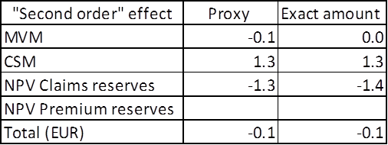
Comparison of the proxy and of the exact amount of “second-order” effect
“Second order” effect consists of the impact of the yield curve change over the ULR movements.
Generally, the proposed proxy gives a fair amount of the potential impacts of the “second order” effect of the yield curve change over the ULR movements on the Balance Sheet.

Slide 36
Conclusions of this example
Complexity of explaining quarterly variations
  Not only change in ULR needs to be explained but also discount, risk adjustment…
  Variation analysis will be a real challenge!
In IFRS 4 Phase 2, “second order” effects may play a role in explaining balance sheets and P&L movements
  It is likely that tracing accounting movements will become much harder
  Perhaps leading the management of a company to have the feeling that he loses the control over his own business.
With this example, it is very obvious that the modelling requires a very detailed knowledge of the portfolio which, in fact, will be difficult to estimate by companies’ quantitative experts.
In particular, the difficulties would come from:
  the granularity of data to gather,
  the required modelling and its IT applications including CPU/run-time,
  the complexity of validating results coming out of the models in order to reach reliable estimates.
Notes:
Contrary to IFRS 4 Phase 1, where the impacts of the different management decisions could always be added and explained easily
Such “second order” effects can, in certain cases, be explained but considering the overall complexity of this accounting standard, it is likely that, in other cases, tracing accounting movements will become much harder leading the management of a company to have the feeling that he loses the control over its own business.

Slide 37
1 | IFRS 4 Phase 2 – A new comprehensive accounting standard
2 | IFRS 4 Phase 2 - Introduction
3 | Risk Adjustment Margin
4 | Challenges
5 | Example
6 | Conclusion

Slide 38



Conclusions
Notes:
Implementation of IFRS 4 phase 2 is likely to be a challenge, especially since the current focus is on Solvency II
Implementation of such complex models provides work and job security for a generation.
Mastering and explaining such models to a management who is already under pressure to keep and produce new profitable business is almost “mission impossible”.

Slide 39
Conclusions
Bad news
  More work for actuaries
  More complexity to deal with
  More data to be delivered by actuaries
Good news
  We have (a lot of) work as a profession for the next few years
  Our profession is going to be very much loved by head hunters !

Slide 40

Next IAA meeting in Zurich in April 2015
Registering for the IAA committee meetings is free
You should attend one or two committee meetings next time in Zurich as observer (8-12 April 2015 – actuaries.org) !
There will also be a special event “International Panel Discussion: From Commutation Numbers to Market Consistency”
Going forward, you should also be participating regularly at AA meetings !
AND YOU MUST REGISTER AS AN ASTIN MEMBER ON ACTUARIES.ORG

Slide 41
Further reading
This presentation is based on the following paper (to be published in “The Journal of Financial Perspectives” (www.gfsi.ey.com)):
“The computational and timing challenge of quarterly non life (re)insurance liability evaluation under IFRS 4 phase 2” by Eric Dal Moro and Jayne Faulkner

